Slide 1
Spring JPA Integration
September 19, 2016

Slide 2
Spring JPA Integration

Slide 3
Objectives
Understanding Spring JPA Integration

Slide 4
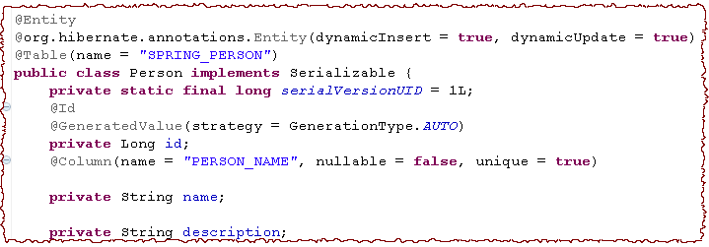
Lets Do It by Spring – JPA Integration
We have a person POJO annotated with JPA annotations.
We want to store the data of person in the database by using Spring-JPA Integration support.

Slide 5
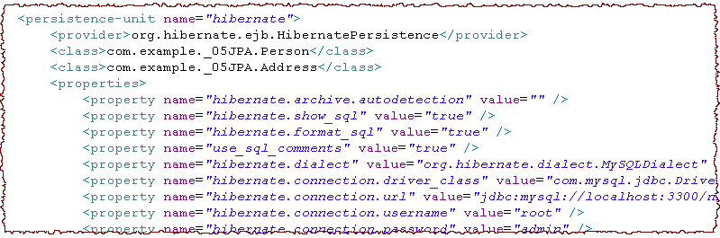
Step 1: Add META-INF/persistence.xml to classpath

Slide 6
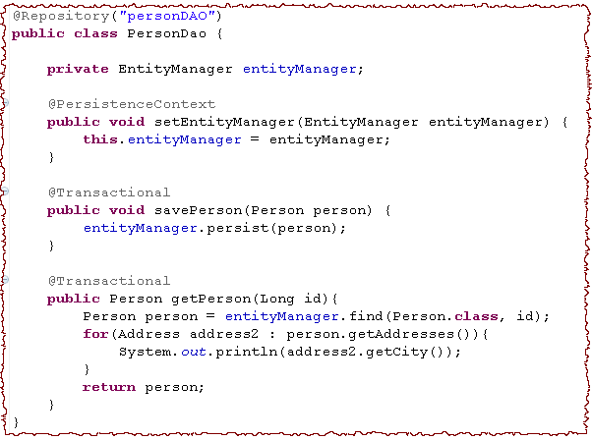
Step 2: Add a DAO class
@Repository Stereotype
EntityManager. JpaTempate is deprecated.
Spring support of JEE standard annotation for JPA
Declarative transaction
If @Transactional is not used, Lazy loading is failed
Notes:
You can annotate each DAO method or the entire DAO class with @Transactional to make all these methods transactional. It ensures that the persistence operations within a DAO method will by executed in the same transaction and hence by the same entity manager.

Slide 7
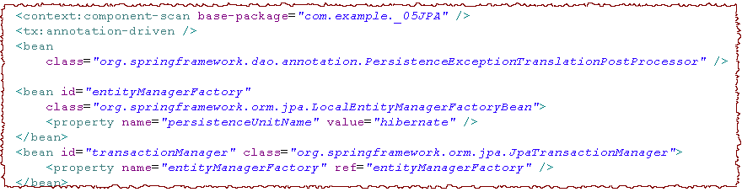
Step 3: Spring XML Configuration
Annotation Driven Transaction
Add Spring exception handling to @Repository
Name transationManager is required
Local Entity Manager Factory
JPA Transaction Manager
To enable declarative transaction management for the methods annotated with @Transactional, you have to enable the <tx:annotation-driven> element in your bean configuration file. By default, it will look for a transaction manager with the name transactionManager.
Notes:
To inject entity managers into properties annotated with @PersistenceContext, either of one is required:
register a PersistenceAnnotationBeanPostProcessor instance
enable the <context:annotation-config> element
enable <context:component-scan>

Slide 8
Exercise : Coding – Spring Hibernate Integration
Create an Equity class with attributes
symbol : String
securityName : String
type : String (Buy / Sell)
qty : int
Create getters and setters for them.
Save the Equity object to the database by Spring-JPA Integration.

Slide 9
Recap
Spring JPA Integration

Slide 10
References
www.javatpoint.com/spring-and-jpa-integration
www.codingpedia.org/ama/java-persistence-example-with-spring-jpa2-and-hibernate/
https://www.petrikainulainen.net/spring-data-jpa-tutorial/

Slide 11
THANK YOU

